Slide 1


IBM Cloud
Designed for your data.
AI ready.
Secure to the core.
IBM Cloud is the cloud for business.
Notes:
Optimize your business. Deliver signature customer experiences. Apply cognitive services to data on any workload. Choose the right cloud.
Key message: Work with IBM as a trusted partner who can help you optimize business processes and establish signature customer experiences through the application of cognitive/AI services on your structured and unstructured data together with both modern and legacy workloads placed on the right type of cloud.
Infrastructure
Presenter:
Name:
Title:
Date:

Slide 2
Agenda
1. Caratteristiche di IBM Cloud
2. Modalità operative

Slide 3



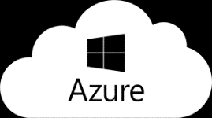


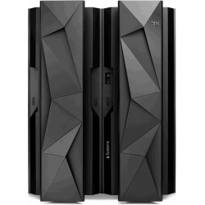
Next Generation Hybrid Multicloud Open Platform
Advise
Move
Build
Manage
Services
†
Applications
Data
Integration
Automation
Multicloud
Management
Certified Offerings
Cloud Pak for Applications
Cloud Pak for
Data
Cloud Pak for Integration
Cloud Pak for Automation
Cloud Pak for Multicloud Management
Cloud Paks
Build
applications
Predict outcomes, automate
data tasks
Connect everything
anywhere
Manage hybrid
environments
Automate work
Foundation
Multi-cluster Management
Red Hat Enterprise Linux
Open Hybrid
Multicloud
Platform
Common Services
Red Hat OpenShift
Infrastructure
Delivery Models
Public | Dedicated | Bare Metal | Managed | Containers | VMs
Infrastructure
IBM Public Cloud
Edge
Private
IBM Power, Z and Storage
3

Slide 4
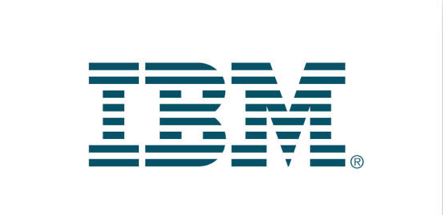
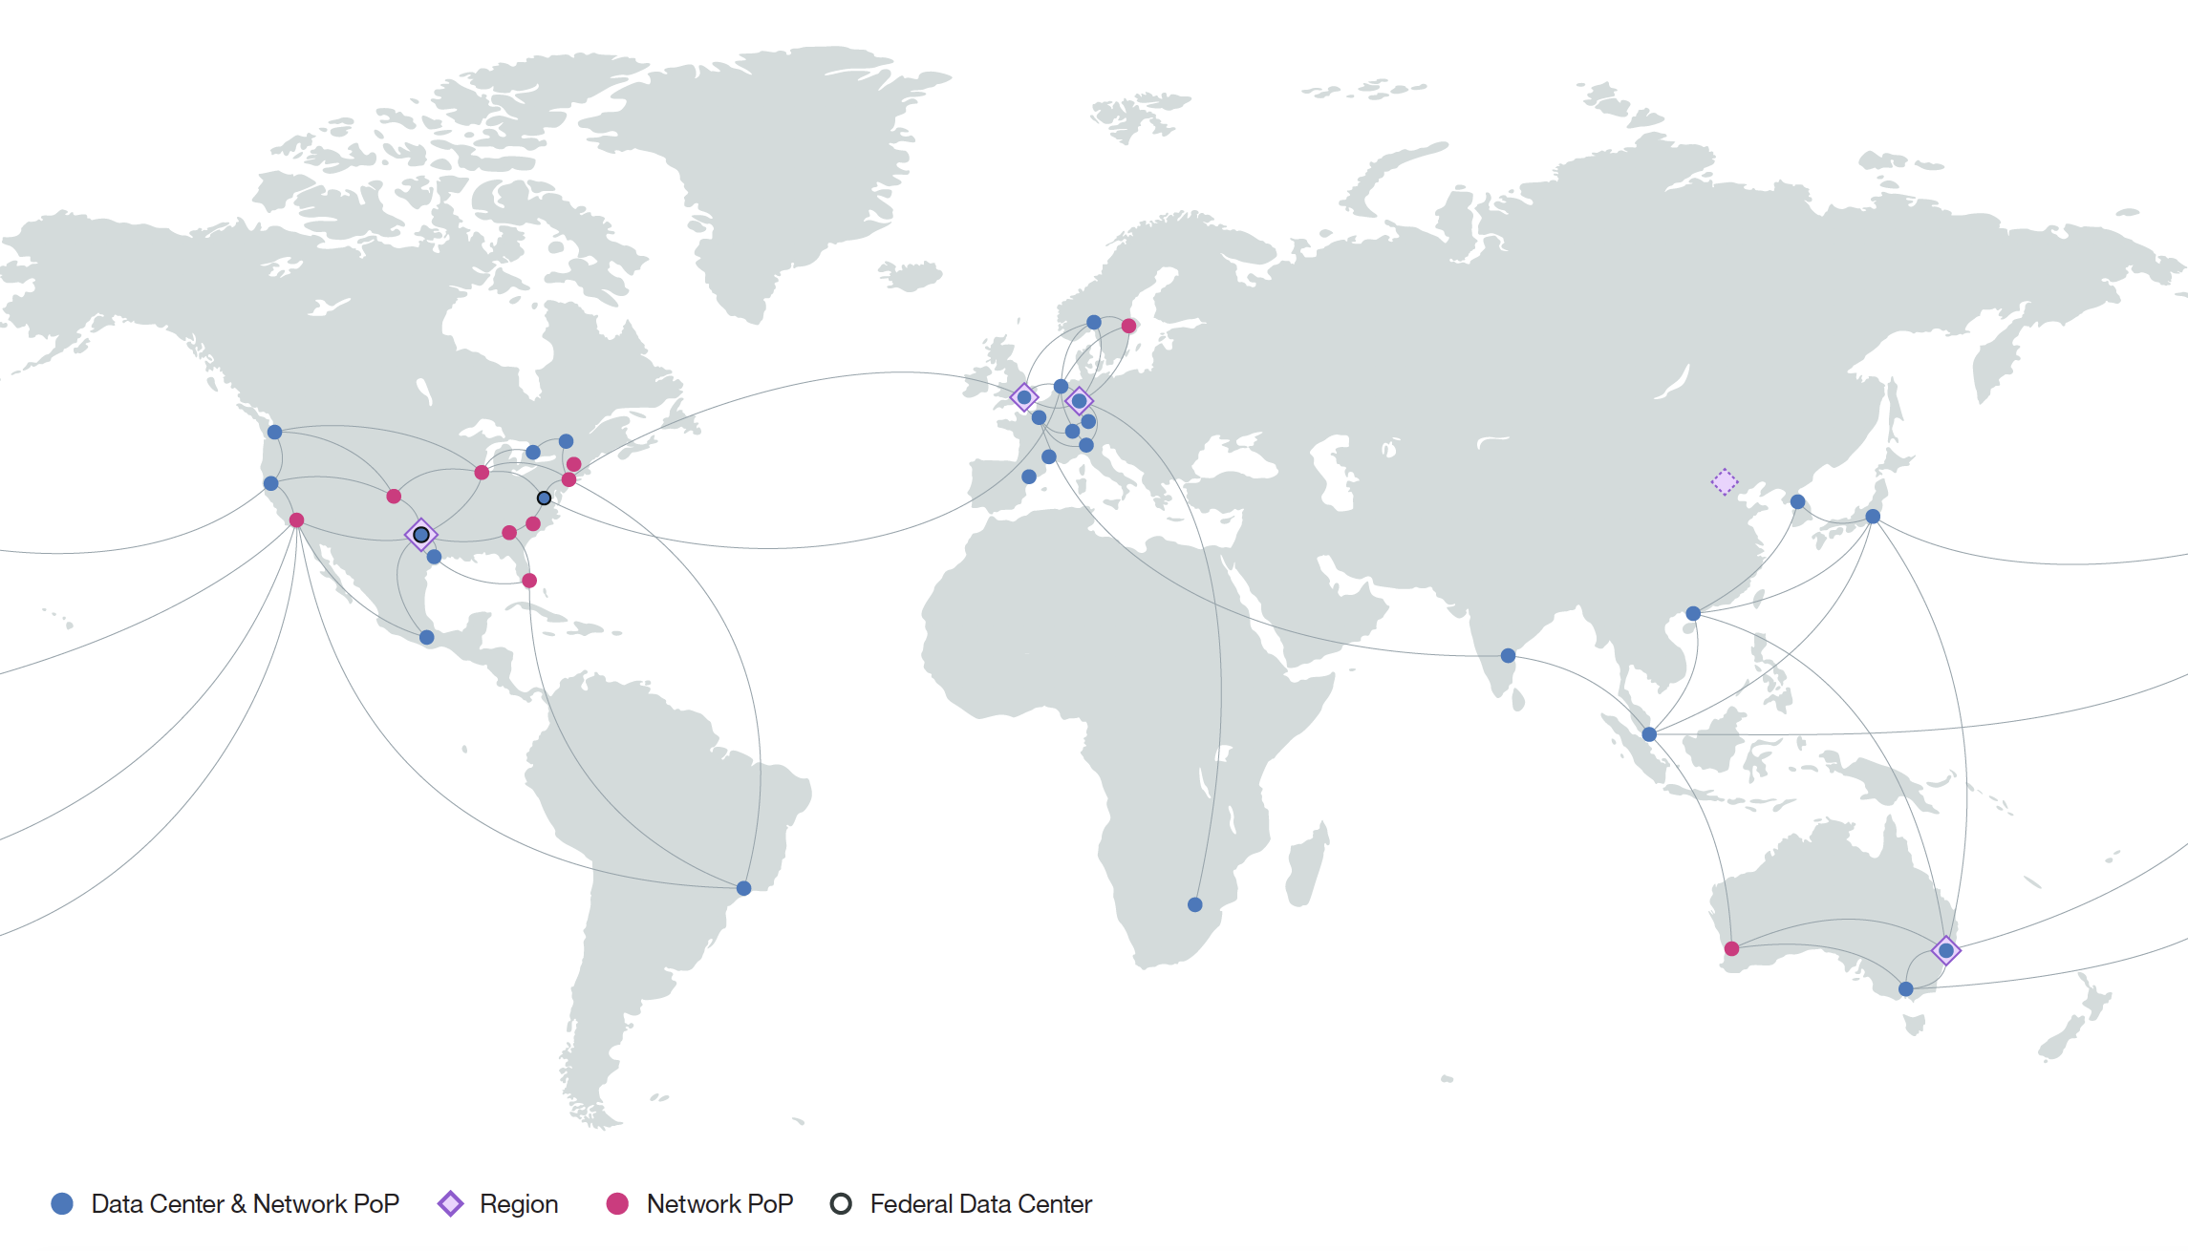

Data Centers: Globally local
Built with multiple deployment options for your unique workload needs
Choose where to deploy
from nearly 60 locations
in 19 countries
MZRs in each region
“The ability to access IBM’s global network of cloud data centers, which are all connected by a high-speed fiber network, is extremely attractive to us.”
-Rob Platzer, chief technology officer, Bitly
IBM Cloud/ © 2018 IBM Corporation
Notes:
13 Tbps of connectivity between data centers and network points of presence
3 networks separate public, private, and internal management networks
56 total data centers around the globe
40 ms of latency onto private networks global
Note: SoftLayer/Bluemix are now referred to as IBM Cloud
Data Centers:
Building and operating a data center involves more than filling a room with servers. Every aspect of an IBM Cloud data center—from location and accessibility to power density and redundancy—is designed to guarantee its security, resiliency, and efficiency. We build each center to the same spec and equip it to provide the full Bluemix catalog of services. And each is staffed 24x7 with experts to troubleshoot and address the rare issues that can’t be directly resolved through our automated management system.
IBM Bare Metal Servers 3x Faster than AWS

Slide 5


IBM Cloud Italian DataCenter
Inaugurato a Giugno 2015
Investimento da 50 Mln $
Capacità per 11,000 servers
Direttamente connesso al Milan Internet Exchange (Mix)
Collegato agli altri IaaS IBM DC con rete private a 80Gbps
Campus pronto per accogliere 7 e più DCs
certificato ANSI TIA 942 A-2014, Rating 4/Tier IV

Slide 6
IBM Cloud Catalogue
IBM Services
AI
Analytics
Application Services
Business Process and Operations
Business Resiliency Services
Business Strategy and Design
Cloud Services
Digital Workplace Services
Network Services
Security Services
Technology Consulting Services
Technology Support Services
Watson Studio
Watson Knowledge Catalog
Watson Assistant
Watson Discovery
Watson Language Translator
Watson Nat. Language Classifier
Watson Nat. Language Understanding
Watson Speech to Text
Watson Text to Speech
Watson Personality Insights
Watson IoT Platform
Data Refinery
Watson Machine Learning
Deep Learning
Analytics Engine
Apache Spark
Decision Optimization
Db2 Warehouse on Cloud
Master Data Mgmt. (MDM) on Cloud
Information Server on Cloud
Streaming Analytics
Security
DevOps
Mobile
Activity Tracker
App ID
Network Security
SSL Certificates
Certificate Manager
Hardware Security Module
Hyper Protect Services
Identity Access Mgmt.
Continuous Delivery
Continuous Release
Globalization Pipeline
Cloud CLI
Availability Monitoring
Cloud Developer Console for Apple
Cloud Event Management
Workload Scheduler
DevOps Insights
Log Analysis
Monitoring
Multi Cloud Manager
Mobile Foundations
App ID
Mobile Analytics
Push Notifications
Databases
Integration
VMware
IoT
Cloudant
IBM Cloud DBs
Db2 Hosted
Db2 on Cloud
Db2 Warehouse
Informix on Cloud
Lift
Mass Data Migration
API Connect
App Connect
Aspera on Cloud
Event Streams
MQ on Cloud
IBM Cloud DB for Rabbit MQ
Direct Link
Secure Gateway
Secure Virtualization
Veeam on IBM Cloud
VMWare Horizon on IBM Cloud
Skytap on IBM Cloud
F5 on IBM Cloud
Fortinet on IBM Cloud
Spectrum Protect Plus on IBM Cloud
Zerto on IBM Cloud
IoT Platform
Weather Data APIs
Compute
Networking
Storage
Bare Metal Servers
Cloud Virtual Servers
Mass Storage Servers
IBM Cloud Private
Container Registry
Kubernetes Service
Cloud Foundry
Cloud Functions
IBM Cloud Dedicated
WAS on Cloud
Auto Scaling
VMWare Cloud Solutions
SAP-Certified Infrastructure
Internet Services
Virtual Router Appliance
DNS
CIS
CDN
Load Balancing
Direct Link
Network Security
Block Storage
File Storage
Object Storage
EVault
Notes:
La lista dei servizi è descritti è direttamente disponibile sul catalogo cloud pubblico IBM :
potete quindi richiedere istanza dalle macchine baremetal dedicate, fino a le API per i machine learning all’interno dello stesso catalogo. Molte delle funzionalità sono state rese o saranno rese a brev disponibili anche su IBM Cloud Private in modo da avere la possibilità di garantire una vista consistente sui prodotti.

Slide 7


























Focus on Compliance & Certifications
IBM Cloud supports deployment of regulated workloads through extensive compliance and clear delineation of roles and responsibilities
IBM Cloud manages to:
IBM Cloud Security Policy
Based on ISO27001
*
NIST SP800-53
IBM Cloud Compliance Demonstrated Through:
*
*
SOC1, SOC2,
SOC3
ISO/IEC 27001
Certification
ISO/IEC 27017
Certification
ISO/IEC 27018
Certification
PCI DSS v3.1 AoC
EUMC upon request
Supported Workloads Include:
*
*
The client is responsible for ensuring compliance with all applicable laws and regulations applicable to it. IBM does not provide legal advice or represent or warrant that its services or products will ensure that the client is in compliance with any law or regulation.
Will Sign BAA
*
JAB pATO (**)
FCC ATO
DOI ATO
*
EU-MC, GPDR
*
*
*
*
(*) IBM Cloud Infrastructure (i.e. SoftLayer) compliance certifications or frameworks completed for infrastructure ONLY at this time. Part of roadmap for platform.
(**) FedRAMP is for dedicated, special purpose FedRAMP data centers located in USA
Notes:
Master Draft 1
Master Draft 1
7

Slide 8

Get started with the IBM Garage
  Collaborate and build new & engaging client experiences
  Apply disruptive technologies, including AI, IOT, Blockchain
  Gain new methods, from design thinking, to agile dev, & lean startup
Notes:
To get started quickly, organizations like American Airlines, Hertz and other have turned to IBM Cloud Garages to speed their journey, bringing together business and IT audiences to collectively reinvent client experiences using next generation technologies from AI and IOT to Blockchain and transformative methods like design thinking.

Slide 9
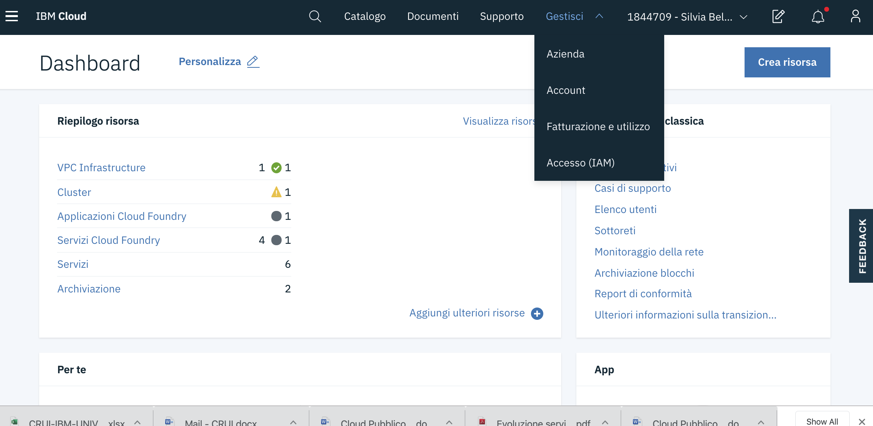

Slide 10
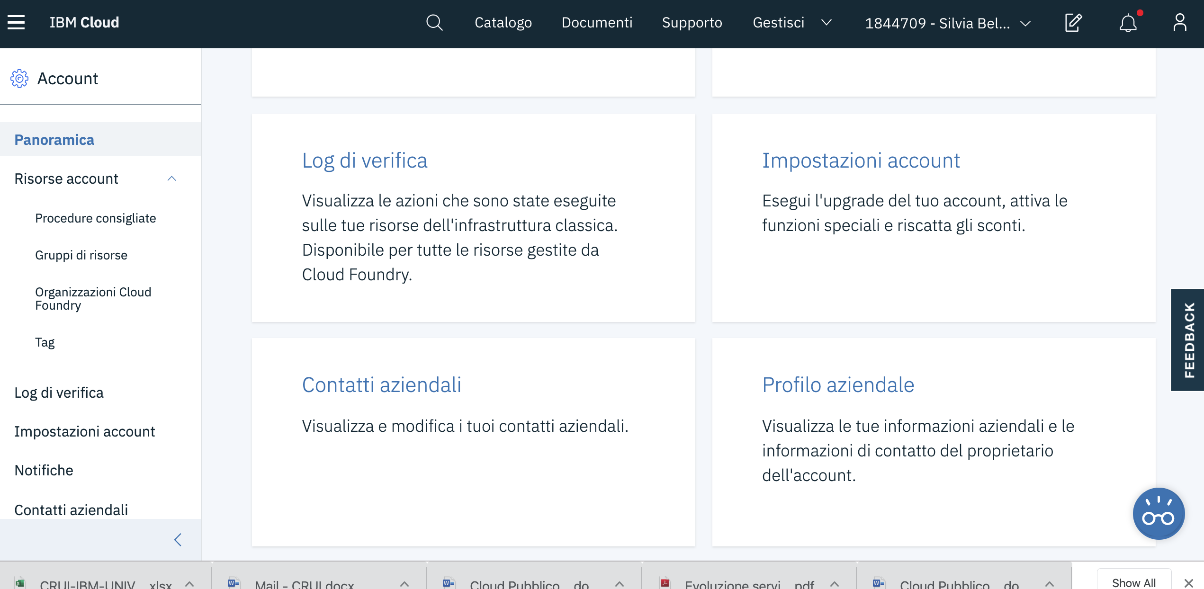

Slide 11
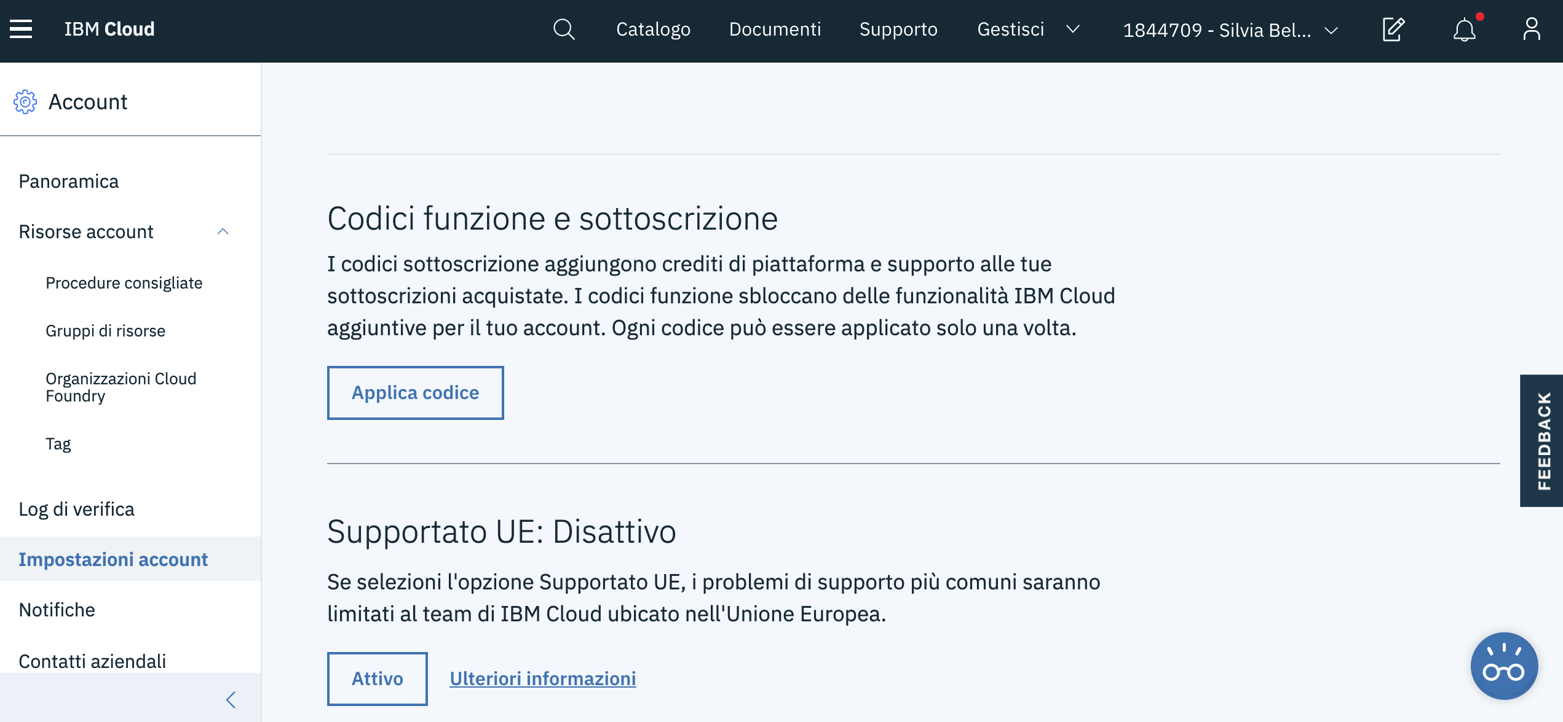

Slide 12
